Slide 1

Notes:
I’m delighted to introduce Northern Irish Connections, the global diaspora initiative for Northern Ireland.

Slide 2
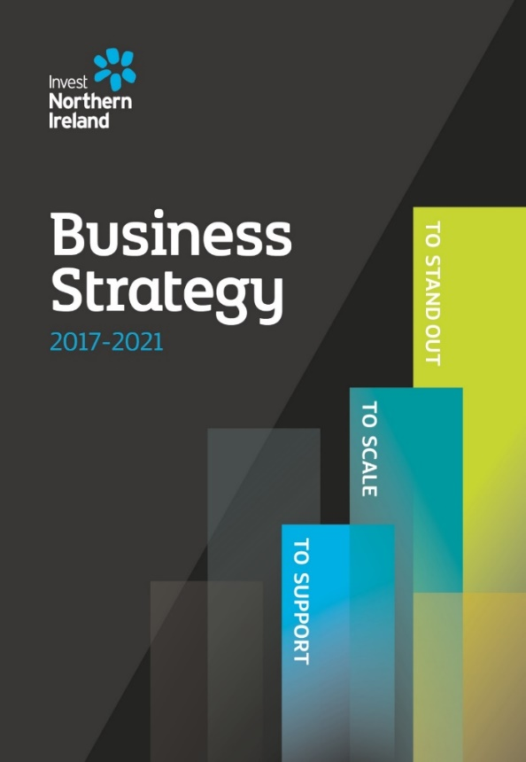

Context
Vision:
A place of opportunity where people want
to live, work, study, visit, invest and do business
Commitment:
Harness the influence and contribution
of diaspora for future economic growth
Attract back talent
Notes:
To put this initiative in context:
Invest NI’s business strategy for 2017-2021 sets out our vision to position Northern Ireland as a place of opportunity where people want to live and work, study, visit, invest and do business.
It states a commitment to re-focus our activity to engage with the diaspora through NI Connections to harness the influence and contribution which this group can bring to our future economic growth, including the potential to attract back talent to thriving sectors of our economy.
Northern Irish Connections is the vehicle through which we will further these ambitions

Slide 3



Team NI Connections
Led by a dedicated
team in Belfast
Working with
diaspora stakeholders
Partnering with
the Invest NI Global
office network
Notes:
Northern Irish Connections is led by a dedicated team in Belfast within Invest NI’s international division. The NIC team
- works collaboratively with diaspora stakeholders across the public and private sector at home and overseas (which includes organisations such as the universities & colleges, colleagues in tourism, members of the start-up ecosystem, local government, and leaders in the business community) and;
- partners with the Invest NI network of 23 offices around the world
What connects us is the drive to enhance the economic prosperity of our region by working with one of our greatest global assets – our diaspora…

Slide 4


The Northern Irish Diaspora
Embraces all those living outside the region who have:
A connection by birth or heritage
or
A strong affinity for Northern Ireland (typically through
a work, study, business or travel experience)
Notes:
For us, the Northern Irish diaspora includes all those connected by birth or heritage as well as those who have a strong affinity for Northern Ireland typically as a result of an education, travel or business experience.
Given this broad definition, it is difficult to quantify the global Northern Irish diaspora but the number of first and second generation Northern Irish around the world is an estimated 10 million with substantial populations in the USA & Canada (est. 8.5m) GB (1.6m) and Australia (0.5m)

Slide 5



NI Connections Mission
Celebrate
Northern Ireland
Harness the talent and influence of
global diaspora to attract new international opportunities
Showcase quality
career opportunities
Notes:
The NI Connections’ Mission is essentially threefold:
1) To Celebrate Northern Ireland as a great place to live, work, study, visit, invest and do business.
2) To harness the talent and influence of our global diaspora to attract new international trade, foreign direct investment, education, innovation and business tourism opportunities.
And
3) Showcase quality career opportunities for those considering return or relocation to thriving sectors of the NI economy.

Slide 6


NI Connections Approach
Building a global online community
Developing a network of diaspora connections
Notes:
To deliver the NI Connections mission we are collectively focused on 2 main objectives:
1) Building a global online community of Northern Irish abroad and friends through uplifting website & social media content that inspires pride and passion (and perhaps a touch of nostalgia) about Northern Ireland and :
2) Developing a network of diaspora connections:
in key locations and priority sectors to actively work with us to attract opportunities in trade, FDI, education, innovation and business tourism and;
Influencers who can support our efforts to promote Northern Ireland as a great place to live, work, study, invest and do business

Slide 7




Online Community
niconnections.com
Northern Irish Connections
@ConnectNI
NorthernIrishConnections
Notes:
The new NI Connections website and social media channels were launched in November 2018
Either run demo https://youtu.be/wv5_NqNnmYg
or
Explain our online approach as follows:
The NIC online content focusses on key themes of:
News – success stories and inspirational achievements from Northern Ireland
Opportunity – showcasing Northern Ireland as a land of opportunity for career, study and enterprise
Connections – spotlighting the accomplishments of our diaspora community
Experience - great things to see and do across the region
The tone that pervades our content across all channels is positivity and passion for Northern Ireland and the subtle thread running through each of our stories is the impact that the success of individuals, groups, business and organisations has on the economic prosperity of Northern Ireland.

Slide 8
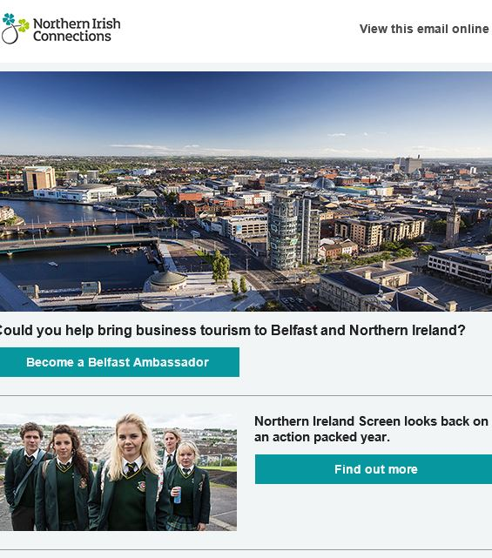
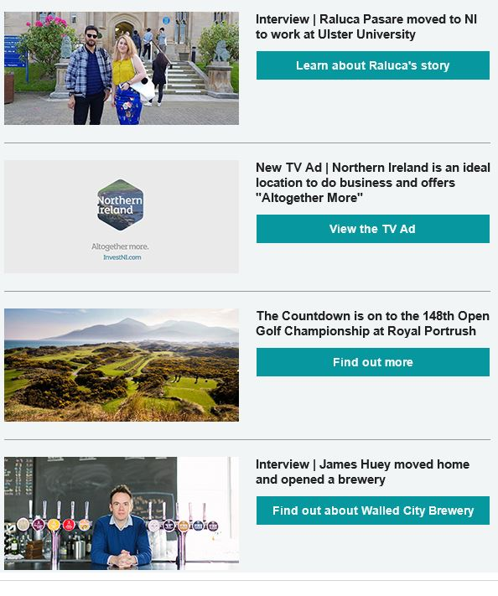
Online Community
Notes:
Our first subscriber newsletter issued in February with the next planned for April

Slide 9
Network development - harnessing the power of our diaspora:
Are a source of immense pride through their achievements overseas
Advocates for Northern Ireland as a compelling location for Foreign Direct Investment
Assist ambitious exporters from Northern Ireland sharing their business acumen,
market access insights & sector expertise
Ambassadors promoting NI as a destination of choice for national and international conferences
Alumni of our renowned educational institutions are the best advertisement for the benefits
of studying in Northern Ireland
Attracted back home for fantastic career opportunities accelerating the growth of our
thriving industries including tech, financial & professional services
Are investing ‘at home’ by establishing new operations and creating quality
employment in Northern Ireland
Notes:
In terms of developing our networks, as evidenced today, in many locations we already benefit from the support of some great diaspora connections who:
Through their own achievements are a source of immense pride
And are inspired to:
passionately advocate for Northern Ireland as a compelling location for FDI
Share their business acumen, market access insights & sector expertise with ambitious exporters from NI
Are energetic ambassadors promoting NI as a destination of choice for national and international conferences
are talented alumni of our renowned educational institutions – the best advertisement for the benefits of studying in Northern Ireland
Are accelerating the growth of our thriving industries including tech, financial & professional services by returning home for fantastic career opportunities or encouraging others to do so
Are investing ‘at home’ by establishing new operations and creating quality employment in Northern Ireland
INSERT MARKET SPECIFIC EXAMPLES
And through NI Connections our objective is to grow these networks and thereby stimulate more of this great activity

Slide 10


Network development
Influencers
Key locations
Priority sectors for NI
Notes:
And so we our ambition is to develop our active networks across a range of geographies by engaging diaspora who are:
Influencers in key locations who can help promote Northern Ireland’s strengths as a place to live, work , study and invest and:
Those with expertise in particular markets and industries willing to help attract trade, investment, education, and business tourism opportunities for Northern Ireland
AT THIS POINT EACH PRESENTER CAN OUTLINE HIS/HER PRIORITY SECTORS & AGENDA as appropriate

Slide 11


How you can help:
Sign-up
Spread the word
Notes:
In closing today we have 2 main calls to action. Our strapline for NI Connections is ‘Be part of it’
At this stage, the ask is simple :
Join our online community
Let us know if there are others in your networks who would be interested in joining us at future events
And here’s how:

Slide 12
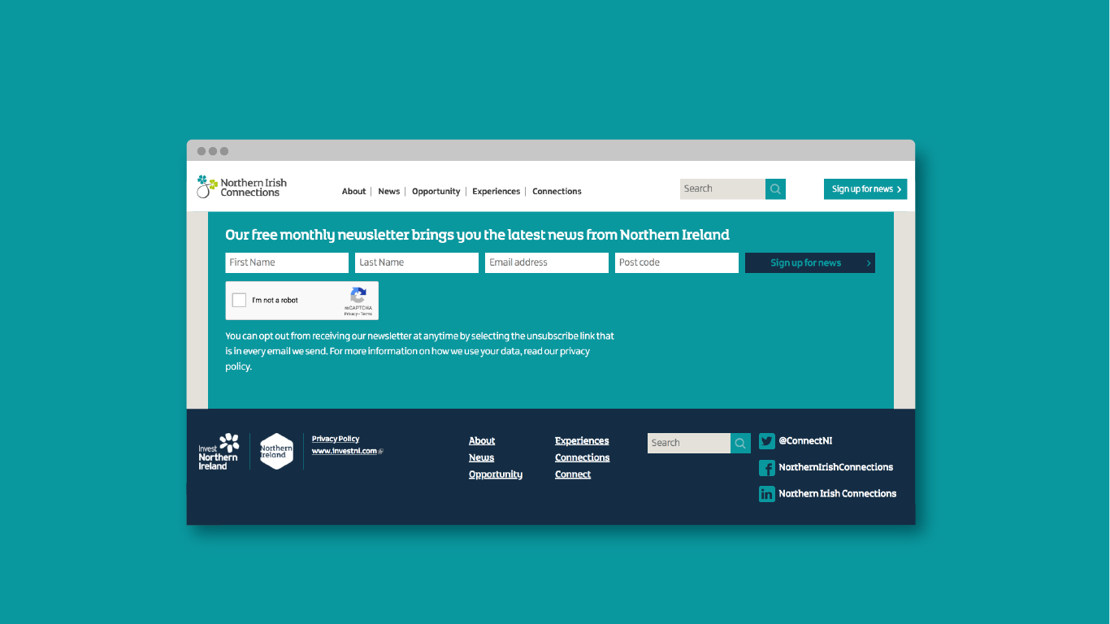

Be part of it
| Subscribe to our bi-monthly newsletter |
niconnections.com
Notes:
Sign up to our newsletter at niconnections.com where you will also find our social media channel details

Slide 13
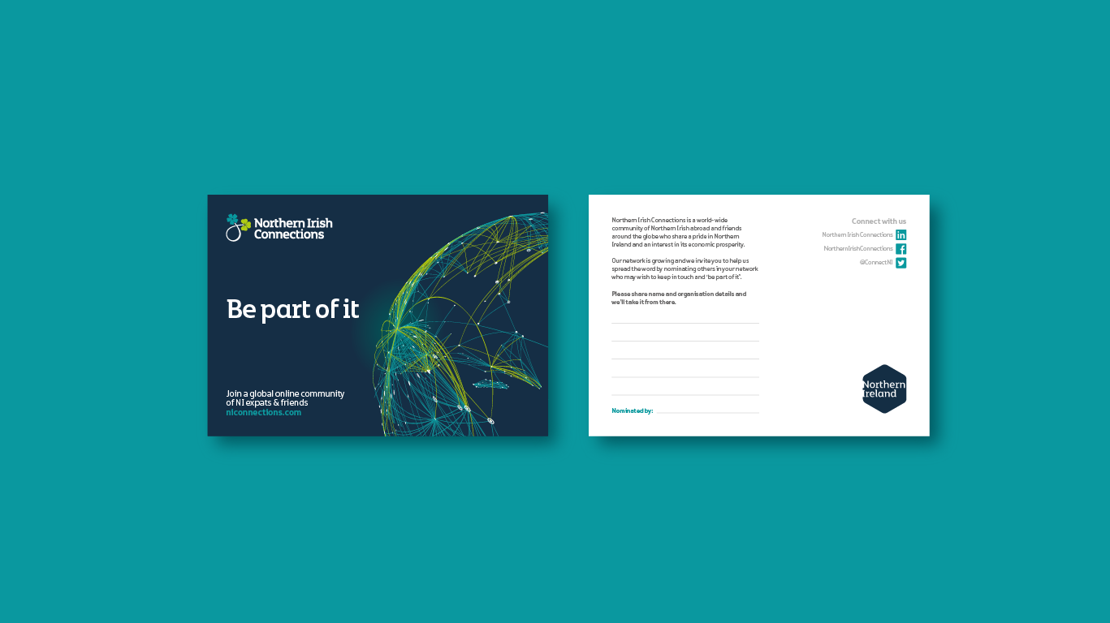
Help us grow
Notes:
And on your tables today we have left you cards on which you can jot down the details of those who you believe may wish to join us at future events.
Please share their name and organization details and we can take it from there.

Slide 14
Thank you
Notes:
Many thanks for joining us today and we look forward to keeping in touch as this great initiative gathers momentum

